Slide 1
IVC Codec Optimization
Albert Iepure
Moisés Jiménez
Email: albert.iepure@tum.de
Email: moises.jimenez@tum.de

Slide 2
Overview
MVFAST algorithm
Half-Pel Accuracy
Chroma Subsampling
Differential Encoding of DC Coefficients
Group of Pictures Structure
Motion Vector Differential Encoding
Deblocking Filters
Conclusion
Notes:
This is the agenda for today’s presentation.

Slide 3
We have added this result because our baseline codec already includes one optimization (namely a wider range of statistics for the Huffman tables). This explains some unexpected results (i.e. MVFAST –> PSNR gain).
Notes:
This is the agenda for today’s presentation.

Slide 4
MVFAST
Motion Vector Field Adaptive Search Technique
Fast block matching ME algorithm
Cityblock lengths of neighboring MV determine:
Search center
Search strategy
Notes:
This paper presents a fast block matching motion estimation algorithm utilizing the information on spatial distribution of local motion vectors. Both the search center and the search strategy for each macroblock are determined based on the cityblock lengths of the neighborhood motion vectors so as to increase the accuracy of motion estimation and achieve high computational gain. The simulations are carried out using MPEG- 4 Verication Model software. Experimental results demonstrate that the proposed algorithm achieves the objective and subjective quality close to that provided by ful l search and at the same time o ers a substantial ly higher search speed.

Slide 5
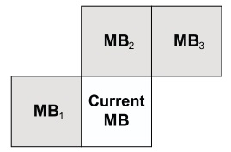
MVFAST - Principle
Figure 1 : Region of support for the current MB
Consists of 3 steps:
Determination of local motion activity
Selection of search center
Local search
Notes:
n the prop osed algorithm, w e make use of the distribution of the same three neigh b orho o d motion v ectors for the dual purp oses increasing the searc h sp eed and reducing the bits needed to co de the motion v ector.

Slide 6
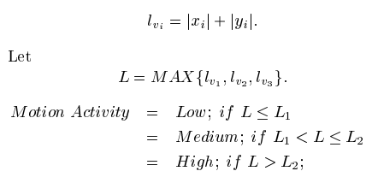
MVFAST – determination of local motion
The MV for the bordering MBs are determined using the full search technique
V = {V0, V1, V2, V3}, where V0 = (0,0)
Cityblock length:
Notes:
n the prop osed algorithm, w e make use of the distribution of the same three neigh b orho o d motion v ectors for the dual purp oses increasing the searc h sp eed and reducing the bits needed to co de the motion v ector.
Let V = f V0 ; V1 ; V2 ; V3 g , where V0 = (0 ; 0) and Vi is the motion v ector of MB i in the ROS (see Fig. 2). The cit yblo c k length Vi = ( x i ; y i ) is dened as
where L 1 (= 1) and L 2 (= 2) are the cit yblo c k distance from the cen ter p oin t of the pattern to an y other p oin t on the small and large searc h patterns

Slide 7
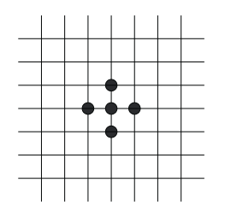
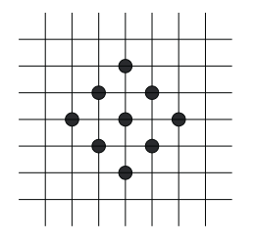
MVFAST – search patterns
Figure 2 : Search patterns: (l) Small Diamond Search Pattern and (r) Large Diamond Search Pattern
Notes:
n the prop osed algorithm, w e make use of the distribution of the same three neigh b orho o d motion v ectors for the dual purp oses increasing the searc h sp eed and reducing the bits needed to co de the motion v ector.
Let V = f V0 ; V1 ; V2 ; V3 g , where V0 = (0 ; 0) and Vi is the motion v ector of MB i in the ROS (see Fig. 2). The cit yblo c k length Vi = ( x i ; y i ) is dened as
where L 1 (= 1) and L 2 (= 2) are the cit yblo c k distance from the cen ter p oin t of the pattern to an y other p oin t on the small and large searc h patterns

Slide 8
MVFAST – selection of search center
Motion activity which is:
Low or Medium => search center is origin
High => search center is given by the Vi which yields the min SAD
Notes:
The c hoice of the searc h cen ter dep ends on the lo cal motion activit y at the curren t MB p osition. If the motion activit y is lo w or medium, the searc h cen ter is the origin. Otherwise, the v ector b elonging to set V that yields the minim um sum of absolute di erence (SAD) is c hosen as the searc h cen ter.

Slide 9
MVFAST – local search
Motion activity which is:
Low or High=> Small Diamond Search (SDS) strategy
Medium => Large Diamond Search (LDS) strategy
Notes:
i) Smal l diamond search (SDS): Step 1: Small diamond searc h pattern (SDSP) is centered at the searc h cen ter, and all the c hec king p oin ts of SDSP are tested. If the cen ter p osition yields the minim um SAD, then the cen ter represen ts the motion v ector (i.e., no motion); otherwise, go to Step 2. Step 2: The cen ter of SDSP mo v es to the p oin t where the minim um SAD w as obtained in the previous step, and all the p oin ts on SDSP are tested. If the cen ter p osition yields the minim um SAD, then the cen ter represen ts the motion v ector; otherwise, recursiv ely rep eat this step. ii) Large diamond search (LDS): Step 1: Large diamond searc h pattern (LDSP) is centered at the serc h cen ter, and all the c hec king p oin ts of LDSP are tested. If the cen ter p osition giv es the minim um SAD, go to Step 3; otherwise, go to Step 2. Step 2: The cen ter of LDSP mo v es to the p oin t where the minim um SAD w as obtained in the previous step, and all the p oin ts on LDSP are tested. If the cen ter p osition giv es the minim um SAD, go to Step 3; otherwise, recursiv ely rep eat this step. Step 3: Switc h the searc h pattern from LDSP to SDSP. The p oin t that yields the minim um SAD, is the nal solution of the motion v ector.

Slide 10
MVFAST Performance vs Standard Codec
Configuration | PSNR [dB] | Bit rate [bpp] | Execution Time (s) | SSD Operations
Standard | 33.491 | 0.598 | 82.140 | 2452160
MVFAST | 33.186 | 0.617 | 74.953 | 528288
Relative Change (%) | 0.882 | 3.221 | 8.750 | 78.452
Maximum speedup: 2452160/528288= 4.641
Actual speedup : 82.140/74.953= 1.095

Slide 11
MVFAST Performance vs Standard Codec

Slide 12
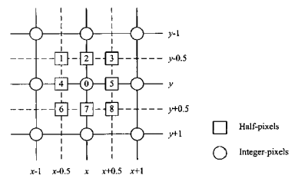

Half-Pel MV Accuracy
Figure 3: The positions of half-pixels
and integer-pixels
Notes:
It is obviously true that integer-pixel search result cannot represent the actual motion vector, since the frame-to-frame displacements of image contents are completely unrelated to the sampling grid. Therefore a suh-pixel search can he perfmned to compensate for the error of integer-pixel motion estimation. It can efficiently reduce error between the original frame and the predicted frame. For this reason, half-pixel motion estimation is adopted as standard in H.263 and MPEG-4 If the center integer-pixel is the integer-pixel component of motion vector obtained hy integer-pixel search, the integer-pixel and the 8 interpolated half-pixels around will he searched in the following half-pixel search so that the half-pixel component of motion vector will be obtained

Slide 13
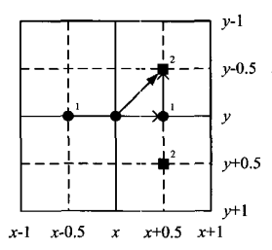
The Two Step Search Algorithm (2SS)
Steps:
The MV determined with MVFAST points to the initial search center
Horizontal search: SAD for (x1-0.5,y1), (x1,y1) and (x1+0.5,y1)
Pixel with minimum SAD becomes vertical search center (x2,y2)
Vertical search: SAD for (x2,y2-0.5), (x2,y2) and (x2,y2+0.5)
The minimum SAD yields the half-pel resolution MV
Figure 4: The 2SS algorithm
Notes:
2SS is the algorithm that sequently searches the minimum SAD’S within the neighborhood on the horizontal and vertical directions so as to find the half-pixel component of motion vector.
In a word, the proposed algorithm can reduce the number of half-pixels searched from eight of the full search algorithm to no more than four, which decreases more than one half of the computational complexity.

Slide 14
Half Pel MV Resolution vs Standard Codec
Configuration | PSNR [dB] | Bit rate [bpp] | Execution Time (s) | SSD Operations
Standard | 33.491 | 0.598 | 82.140 | 2452160
Half Pel MV | 34.768 | 0.549 | 83.125 | 2606646
Relative Change (%) | 3.81 | 8.147 | 1.011 | 6.3
Complexity increase: 2606646/2452160= 1.063
Actual computational time increase: 83.125/82.140= 1.011

Slide 15
Half Pel MV Resolution vs Standard Codec

Slide 16
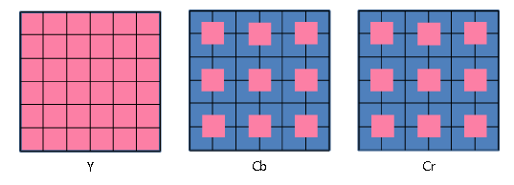
Chroma Subsampling
Figure 5 : The 4:2:0 Subsampling Type

Slide 17
Chroma Subsampling vs Standard Codec
Configuration | PSNR [dB] | Bit rate [bpp] | Execution Time (s) | SSD Operations
Standard | 33.491 | 0.598 | 82.140 | 2452160
Chroma Subsampling | 32.878 | 0.532 | 48.453 | 2452160
Relative Change (%) | 1.83 | 10.961 | 41.011 | 0
Considerable reduction of processing time.
Stream to encode is 50% shorter.

Slide 18
Chroma Subsampling vs Standard Codec

Slide 19
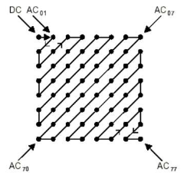
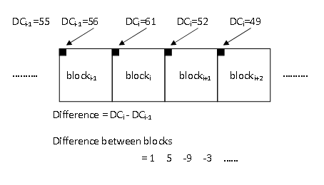
Differential Coding of DC Coefficients
Figure 6: The AC/DC coefficients and DC differential coding
Notes:
After the quantization of the DCT coefficients, the
DC coefficient and the 63 AC
coefficients are treated differently. Since the DC
coefficients usually contain a large
part of the total energy in an image, the quantized
DC coefficient is encoded by
differential encoding which encode the DC coefficie
nt as the difference from the
previous quantized DC coefficient. Differential DC
encoding is performed in a
defined order as shown in Fig. 3.5.
As mention above, the DC and AC coefficients are en
coded with different code
table
By adopting differential coding the entropy can be
greatly reduced owing
to the space correlation of image.

Slide 20
Differential Coding of DC vs Standard Codec
Configuration | PSNR [dB] | Bit rate [bpp] | Execution Time (s) | SSD Operations
Standard | 33.491 | 0.598 | 82.140 | 2452160
Differential Coding | 33.491 | 0.589 | 81.656 | 2452160
Relative Change (%) | 0 | 1.464 | 0.589 | 0
Barely noticeable improvement in terms of bitrate.

Slide 21
Differential Coding of DC vs Standard Codec

Slide 22
Group of Pictures Structure
I
B0
B1
P0
B1
B3
P1
I, P and B frames
B frames quantized more strongly
PSNR drop is indistinguishable
Bit rate gain is considerable

Slide 23
Group of Pictures vs Baseline
Configuration | PSNR [dB] | Bit rate [bpp] | Execution Time (s) | SSD Operations
Standard | 33.49 | 0.5984 | 82.140625 | 2452160
Group of Pictures | 32.81 | 0.4232 | 86.8593 | 4046064
Relative Change (%) | 2.02 | 29.27 | 5.7446 | 65
Slight decrease in overall PSNR
Considerable decrease in bit rate
Computationally complex
Not considering reordering complexity

Slide 24
Group of Pictures vs Baseline

Slide 25



Motion Vector Differential Encoding
I
n
n+1
Algorithm
$$MV_{n+1e}=MV_{n+1}−MV_{n}$$
$$MV_{n+1}=MV_{n}+dec(MV_{n+1e})$$
$$MV_{n}=MV_{n+1}$$
Encode spatial difference of motion vectors
First motion vector is not encoded
Lossless compression
MV statistics are improved

Slide 26
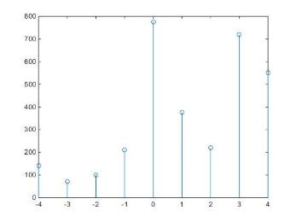
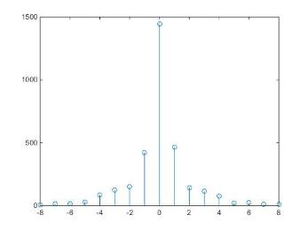
Motion Vector Differential Encoding
Original PDF
Differential PDF
Statistical improvement
Explotaition of Huffman code characteristics

Slide 27
MV Differential Encoding vs Standard Codec
Configuration | PSNR [dB] | Bit rate [bpp] | Execution Time (s) | SSD Operations
Standard | 33.491 | 0.5984 | 82.140 | 2452160
Chroma Subsampling | 33.491 | 0.5906 | 83.281 | 2452160
Relative Change (%) | 0 | 1.30 | 1.388 | 0
Slight decrease in bit rate
Slight increase in processing time

Slide 28
MV Differential Encoding vs Standard Codec

Slide 29
Final Configuration
MV Fast Algorithm
Half-Pel Accuracy
Chroma Subsampling or
Differential Encoding of DC Coefficients
Group of Pictures Structure
Motion Vector Differential Encoding
Deblocking Filters
Notes:
This is the agenda for today’s presentation.

Slide 30
Final Configuration (CS) vs Standard Codec
Configuration | PSNR [dB] | Bit rate [bpp] | Execution Time (s) | SSD Operations
Standard | 33.491 | 0.5984 | 82.140 | 2452160
Final Configuration | 32.621 | 0.356 | 42.484 | 725226
Relative Change (%) | 2.599 | 40.440 | 48.278 | 70.425
Slight decrease in PSNR (not noticeable)
Substantial decrease in processing time
Substantial decrease in bit rate

Slide 31
Final Configuration (CS) vs Standard Codec

Slide 32
Final Configuration (DC) vs Standard Codec
Configuration | PSNR [dB] | Bit rate [bpp] | Execution Time (s) | SSD Operations
Standard | 33.491 | 0.5984 | 82.140 | 2452160
Final Configuration | 33.337 | 0.400 | 73.953 | 725226
Relative Change (%) | 0.460 | 33.045 | 9.967 | 70.425
Slight decrease in PSNR (negligible)
Considerable decrease in processing time
Considerable decrease in bit rate

Slide 33
Final Configuration (DC) vs Standard Codec

